Slide 1

LoRA: Low-Rank Adaptation of Large Language Models 🧩
NGUYEN BUI NGOC HAN
2023.06.09

Slide 2
TABLE OF CONTENTS
01
Low-rank Adaption
02
Experimental Research

Slide 3
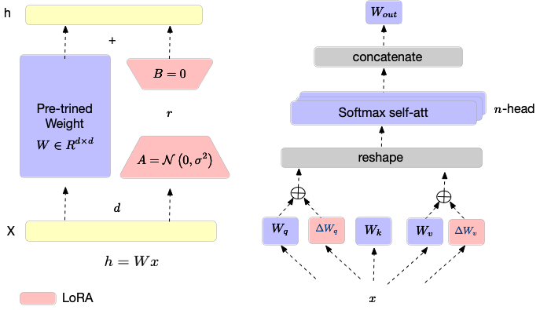
LOW-RANK ADAPTION
LoRA (Low-Rank Adaptation) is a novel framework that addresses the challenges of language models. It leverages low-rank matrix factorization techniques to adapt the parameters of language models. By incorporating task-specific information, LoRA enhances the model's ability to capture domain-specific knowledge and improves overall performance.
Model Summary

Slide 4
LOW-RANK ADAPTION
Benefit
enables efficient parameter adaptation for different tasks without substantial increases in model size.
enhances generalization and out-of-domain performance
reduces overfitting and allows for better utilization of limited training data.

Slide 5

LOW-RANK ADAPTION
Overview
Task | Dataset | GPT-3 fewshot | GPT3 fine-tuned
Q&A | SQuAD v2 (F1) | 69.8% | 88.4%
Textual Entailment | RTE (Acc) | 69% | 85.4%
NL2SQL | WikiSQL (Acc) | 20% | 73%
 | Spider (Acc) | 18% | 62%
Pre-training
Fine-tuning

Slide 6


LOW-RANK ADAPTION
To finetune GPT-3 model
Minimum 96 NVIDIA V100 32GB
1TB per checkpoint

Slide 7
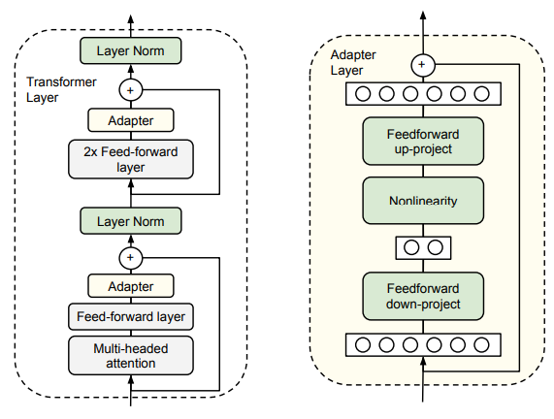
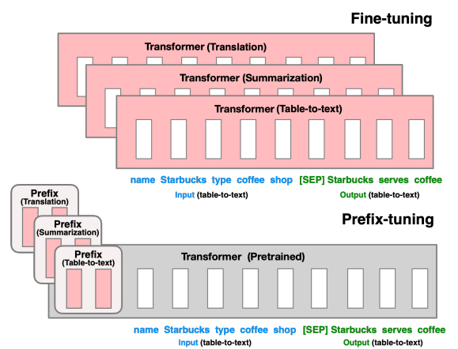
LOW-RANK ADAPTION
Parameter-Efficient Adaption
High-quality but add latency
No latency, but suboptimal quality
Parameter-Efficient Transfer Learning for NLP (2019)
Prefix-Tuning: Optimizing Continuous Prompts for Generation (2021)

Slide 8
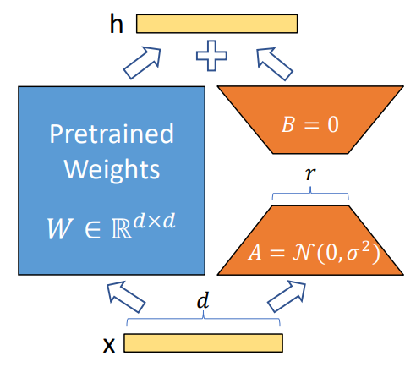
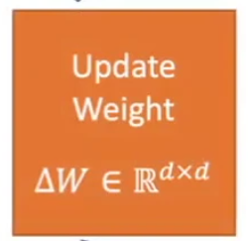
LOW-RANK ADAPTION
Low-Rank Adaption
High-quality but add latency
Parameter-Efficient Transfer Learning for NLP (2019)

Slide 9
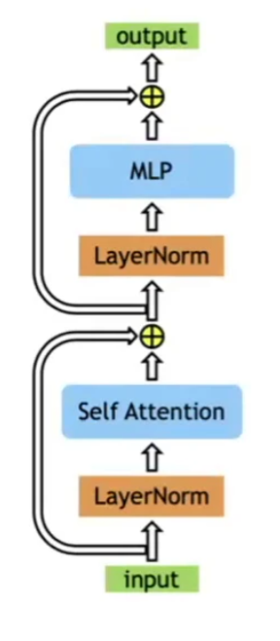
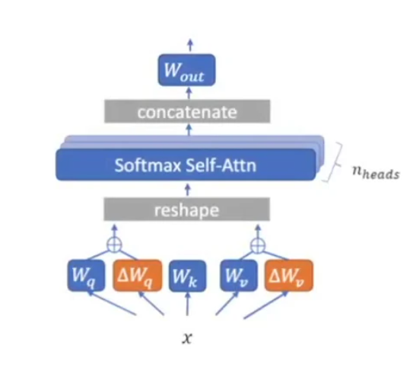
LOW-RANK ADAPTION
Low-Rank Adaption
Apply LoRA to W_{q} and W_{v} to reduce number of trained parameters

Slide 10
LOW-RANK ADAPTION
To finetune GPT-3 model
Minimum 96 24 NVIDIA V100 32GB
1TB 200MB per checkpoint

Slide 11
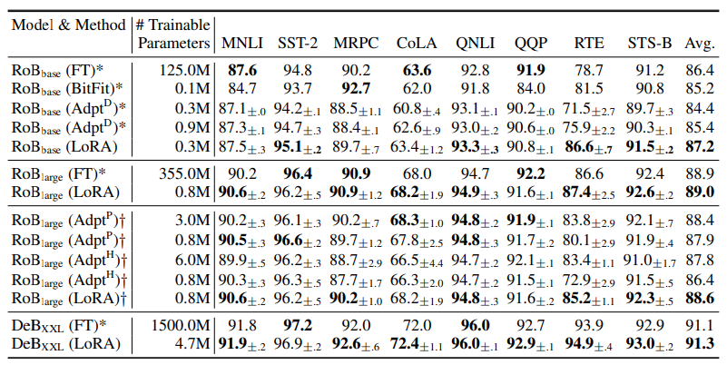
LOW-RANK ADAPTION
Performance
Adaption methods vs. LoRA

Slide 12
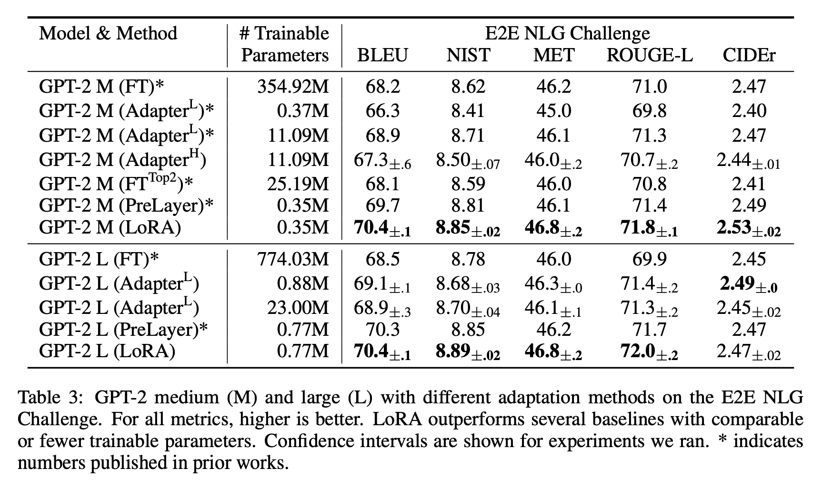
LOW-RANK ADAPTION
Performance
GPT-2

Slide 13
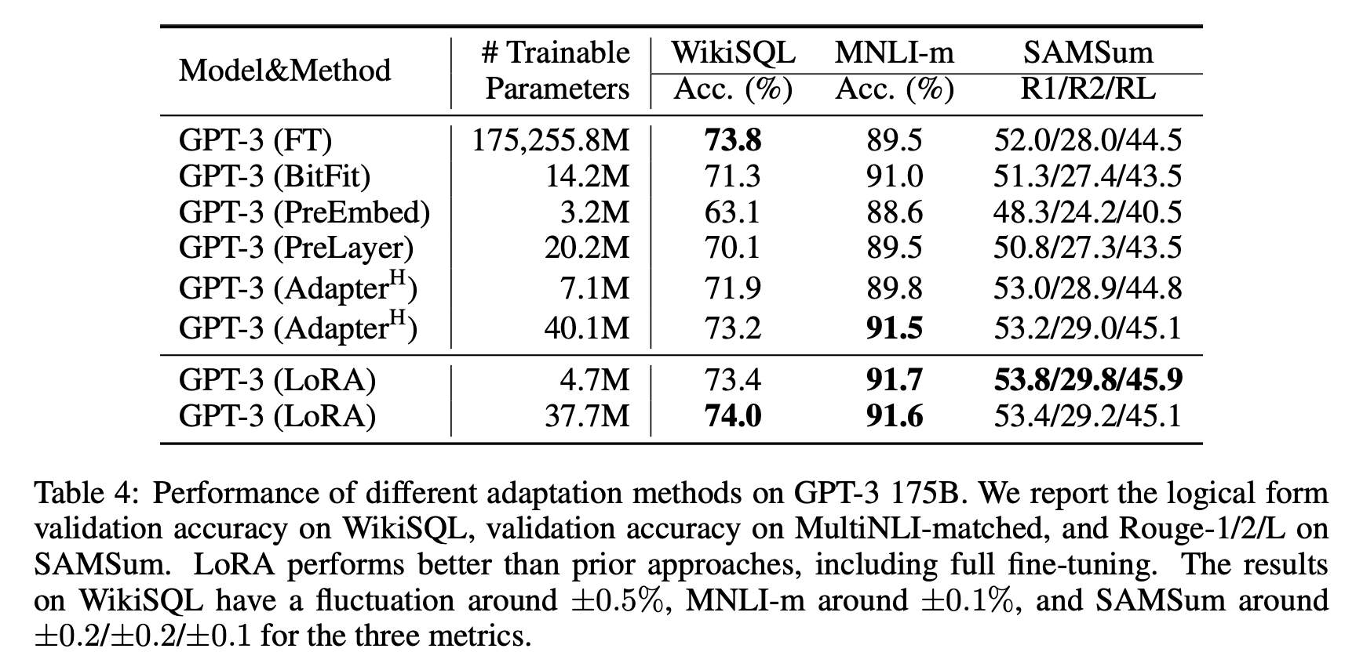
LOW-RANK ADAPTION
Performance
GPT-3

Slide 14
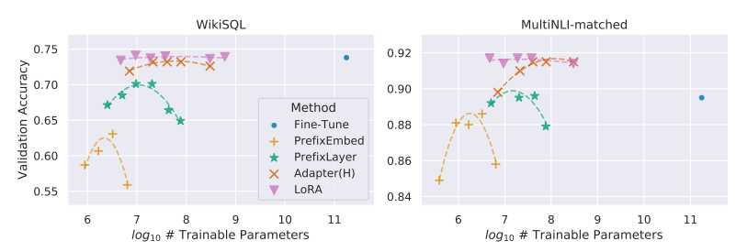
LOW-RANK ADAPTION
Performance versus # of parameters

Slide 15
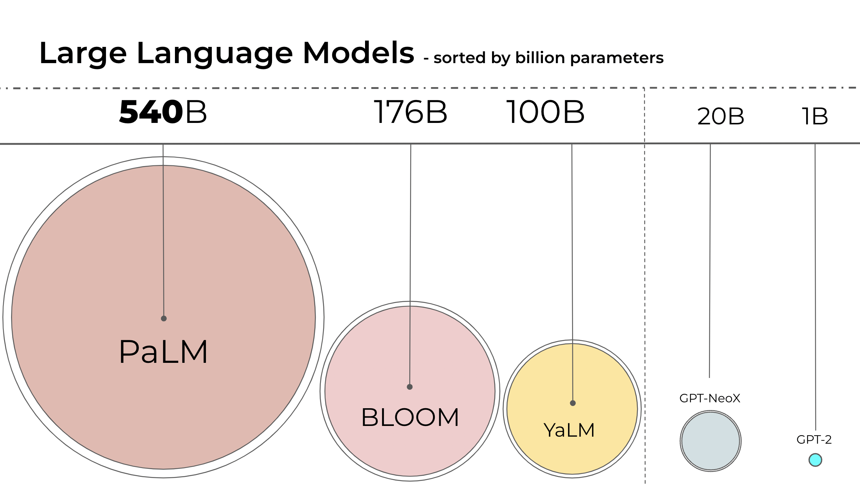
LOW-RANK ADAPTION
Training
Extensive experiments were conducted to evaluate the effectiveness of LoRA.
Bloomz – 1.1B parameters
385,351,680 embedding parameters
24 layers, 16 attention heads
Hidden layers are 1536-dimensional
Direct Use:
Text generation
Exploring characteristics of language generated by a language model
Downstream use: Tasks that leverage language models includes:
Information Extraction
Question Answering
Summarization

Slide 16
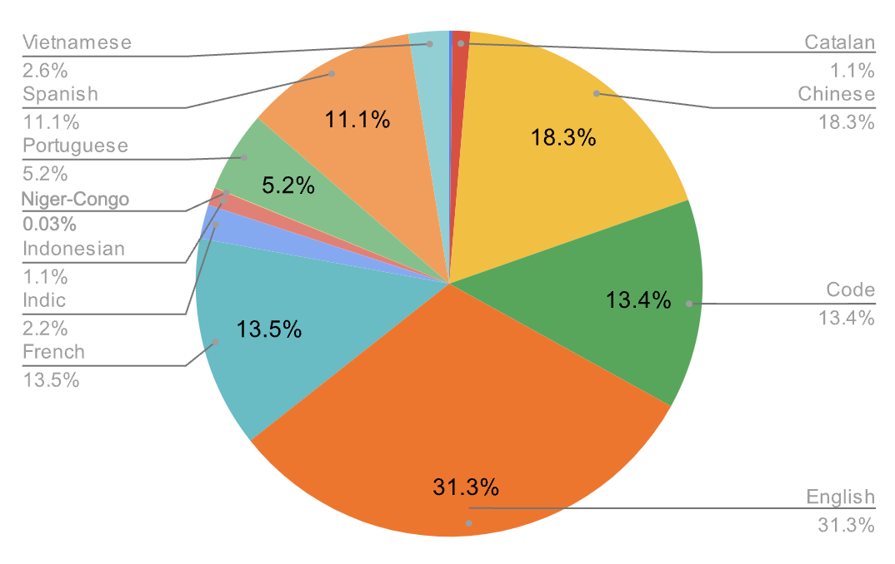
LOW-RANK ADAPTION
Training
Dataset used for training the model

Slide 17
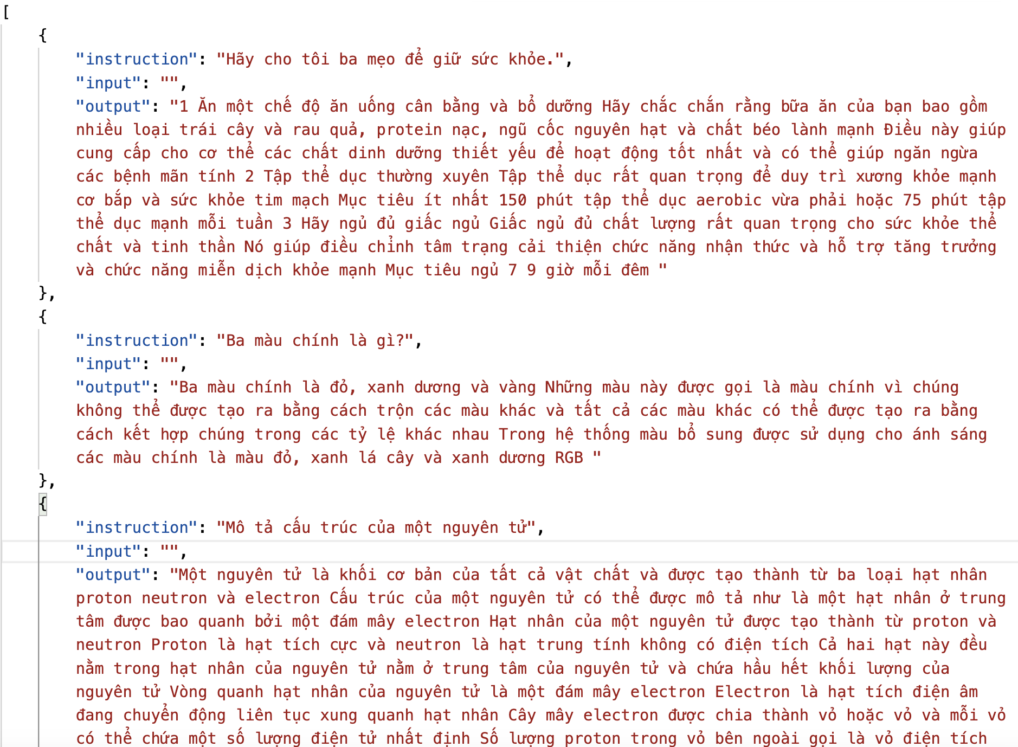
LOW-RANK ADAPTION
Training
Dataset used for training the model (9.18 MB) --> down to 10k
- Alpaca data contains 52k instruction-following data. This JSON file is a list of dictionaries, each dictionary contains the following fields:
instruction: str, describes the task the model should perform. Each of the 52K instructions is unique.
input: str, optional context or input for the task. For example, when the instruction is "Summarize the following article", the input is the article. Around 40% of the examples have an input.
output: str, the answer to the instruction as generated by text-davinci-003
https://github.com/tatsu-lab/stanford_alpaca#data-release

Slide 18
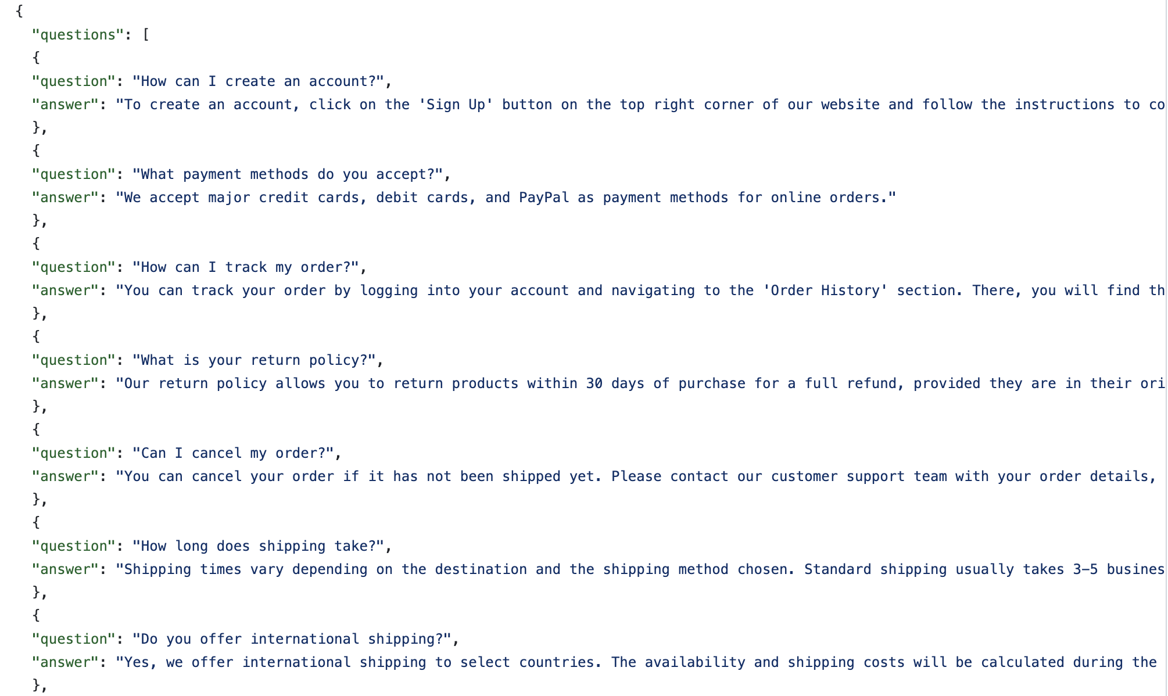
LOW-RANK ADAPTION
Training
Dataset used for training the model: (20.5 KB)
- E-commerce dataset. This JSON file is a list of dictionaries, each dictionary contains the following fields:
question: str, A text string containing a question.
answer: str, ontaining the answer to the corresponding question.
The questions and answers in this dataset relate to common topics in e-commerce, such as how to create an account, payment methods, order tracking, return policies, and order cancellations. and shipping time.
https://www.kaggle.com/code/saadmakhdoom/ecommerce-faq-chatbot/input?fbclid=IwAR1mlds8uqPYzp-kiXuTIGlfnoJhkmH4qkMe92mD7FBGenK62nnUfjH2ras

Slide 19
LOW-RANK ADAPTION
Training
LoRA config
Training config
r = 8: attention heads
Lora_alpha = 16: alpha scaling
lora_dropout = 0.05
batch_size = 2
warmup_steps=100
max_steps=150
learning_rate=2e-4
fp16=True

Slide 20
LOW-RANK ADAPTION
Evaluation
E-Commerce (en)

Slide 21
LOW-RANK ADAPTION
Evaluation
E-Commerce (vi)

Slide 22
LOW-RANK ADAPTION
Evaluation
Alpaca-10k (vi)

Slide 23
LOW-RANK ADAPTION
Evaluation
Dataset | Perplexity | BLEU
E-Commerce (en)
E-Commerce (vi)
Alpaca-10k (vi)

Slide 24

THANK YOU

